Slide 1
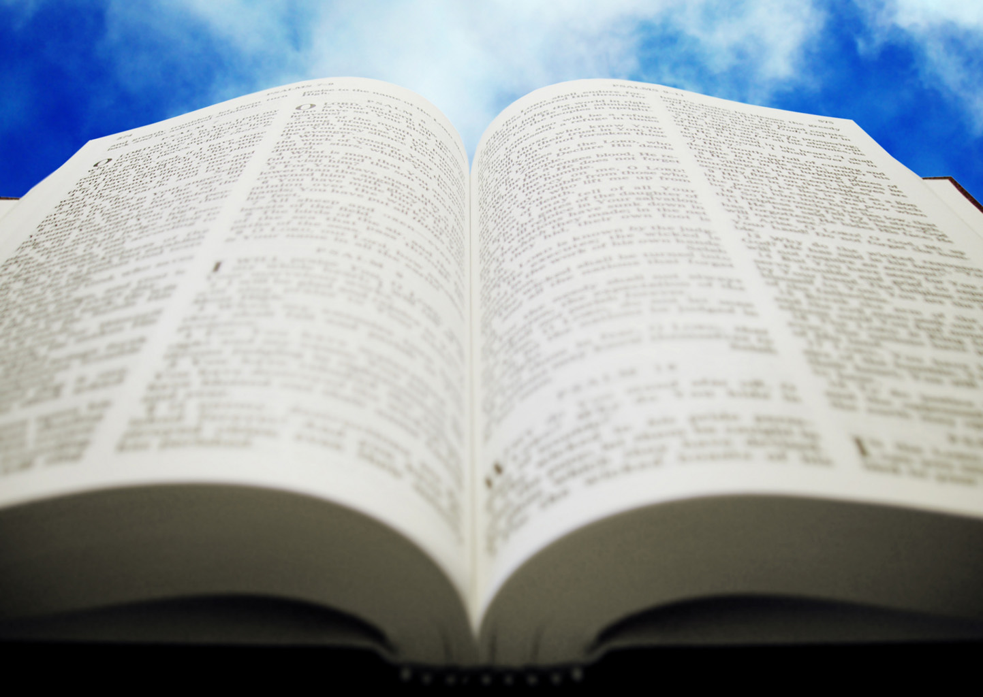
Welcome!
Sunday
Bible Study 9:30 AM
Worship 10:30 AM
PM Bible Class (Livestream) 5:00 PM
Wednesday
Bible Class 7:00 PM
www.SunsetchurchofChrist.net

Slide 2
John 4:39-44
The conclusion of the Samaritan interaction
Contrasted with Galilee

Slide 3
Welcome!
Sunday
Bible Study 9:30 AM
Worship 10:30 AM
PM Bible Class (Livestream) 5:00 PM
Wednesday
Bible Class 7:00 PM
www.SunsetchurchofChrist.net

Slide 4
Opening Prayer | Michael Hetzer
Song – | George Watkins
Scripture Reading | Rob Wade
Song – | George Watkins
Song – | George Watkins
Lord’s Supper | Rob Wade, Brian Haines
Song – | George Watkins
Collection | Rob Wade, Brian Haines
Song – | George Watkins
Lesson | Brian Haines
Song – | George Watkins
Closing | Rob Wade

Slide 5
Am I a Member of the Local Church

Slide 6
Fellowship Membership 1 John 1 1 Corinthians 12
Notes:
1 john 1:3-7
1 Corinthians 12:12-27

Slide 7
Fellowship
Membership
Walking in the light
Universal church
At baptism
Place in a church
Local church
With identification
Notes:
Ga 6:9 And let us not grow weary while doing good, for in due season we shall reap if we do not lose heart.

Slide 8
Fellowship
Membership
Fellowship broken:
When we cease to walk in the light
Membership broken
When we are put out by the church (over fellowship)
Notes:
Ga 6:9 And let us not grow weary while doing good, for in due season we shall reap if we do not lose heart.

Slide 9
Fellowship
Membership
You cannot inherit eternal life unless you are in fellowship with Christ and His people
You cannot inherit eternal life unless you are in membership with Christ and His people
Notes:
Ga 6:9 And let us not grow weary while doing good, for in due season we shall reap if we do not lose heart.

Slide 10
Testing Your Membership
1. Have I made my membership known?
And when Saul had come to Jerusalem, he tried to join the disciples; but they were all afraid of him, and did not believe that he was a disciple. Acts 9:26
Notes:
Ga 6:9 And let us not grow weary while doing good, for in due season we shall reap if we do not lose heart.

Slide 11
Testing Your Membership
2. Am I participating in the body?
Hebrews 10:25 – in worship
1 Corinthians 16:1-2 – in support
1 Corinthians 5:4 – in discipline

Slide 12
Testing Your Membership
3. Do I see the needs of the body as mine?
Philippians 2:1-4
Philippians 3:15-16
Romans 12:16
Notes:
Php 2:1 ¶ Therefore if there is any consolation in Christ, if any comfort of love, if any fellowship of the Spirit, if any affection and mercy, 2 fulfill my joy by being like-minded, having the same love, being of one accord, of one mind. 3 Let nothing be done through selfish ambition or conceit, but in lowliness of mind let each esteem others better than himself. 4 Let each of you look out not only for his own interests, but also for the interests of others.
Php 3:15 ¶ Therefore let us, as many as are mature, have this mind; and if in anything you think otherwise, God will reveal even this to you. 16 Nevertheless, to the degree that we have already attained, let us walk by the same rule, let us be of the same mind.
Ro 12:16 Be of the same mind toward one another. Do not set your mind on high things, but associate with the humble. Do not be wise in your own opinion.

Slide 13
Testing Your Membership
4. Can the church depend on me?
Acts 15:36-39
2 Timothy 4:11
1 Corinthians 12:15-17
Notes:
Ac 15:36 ¶ Then after some days Paul said to Barnabas, "Let us now go back and visit our brethren in every city where we have preached the word of the Lord, and see how they are doing.“ 37 Now Barnabas was determined to take with them John called Mark. 38 But Paul insisted that they should not take with them the one who had departed from them in Pamphylia, and had not gone with them to the work. 39 Then the contention became so sharp that they parted from one another. And so Barnabas took Mark and sailed to Cyprus;
2Ti 4:11 Only Luke is with me. Get Mark and bring him with you, for he is useful to me for ministry.
1Co 12:15 If the foot should say, "Because I am not a hand, I am not of the body," is it therefore not of the body? 16 And if the ear should say, "Because I am not an eye, I am not of the body," is it therefore not of the body? 17 If the whole body were an eye, where would be the hearing? If the whole were hearing, where would be the smelling?

Slide 14
Fellowship
Membership
Sometimes people think they are in fellowship with Christ but they are not
Sometimes people think they are members of Christ’s churches but they are not
Notes:
Ga 6:9 And let us not grow weary while doing good, for in due season we shall reap if we do not lose heart.

Slide 15
Importance of Membership
The danger of being an attendee only
Failing to perform the tasks given by God
The danger of being an absentee member
Failing short of the Divine expectation
Notes:
Ga 6:9 And let us not grow weary while doing good, for in due season we shall reap if we do not lose heart.

Slide 16
Importance of Membership
Membership in the body denies the self
Membership in the body secure inheritance
Notes:
Ga 6:9 And let us not grow weary while doing good, for in due season we shall reap if we do not lose heart.

Slide 17
Notes:
Lu 18:10 "Two men went up to the temple to pray, one a Pharisee and the other a tax collector. 11 "The Pharisee stood and prayed thus with himself, 'God, I thank You that I am not like other men--extortioners, unjust, adulterers, or even as this tax collector. 12 'I fast twice a week; I give tithes of all that I possess.‘ 13 "And the tax collector, standing afar off, would not so much as raise his eyes to heaven, but beat his breast, saying, 'God, be merciful to me a sinner!‘ 14 "I tell you, this man went down to his house justified rather than the other; for everyone who exalts himself will be humbled, and he who humbles himself will be exalted.“
Mr 11:25 "And whenever you stand praying, if you have anything against anyone, forgive him, that your Father in heaven may also forgive you your trespasses.

Slide 18
Are You Heard by God?
God does not hear everyone – John 9:31
He hears those who have contrition
He hears those who worship Him
He hears those who walk with Him
Notes:
Lu 18:10 "Two men went up to the temple to pray, one a Pharisee and the other a tax collector. 11 "The Pharisee stood and prayed thus with himself, 'God, I thank You that I am not like other men--extortioners, unjust, adulterers, or even as this tax collector. 12 'I fast twice a week; I give tithes of all that I possess.‘ 13 "And the tax collector, standing afar off, would not so much as raise his eyes to heaven, but beat his breast, saying, 'God, be merciful to me a sinner!‘ 14 "I tell you, this man went down to his house justified rather than the other; for everyone who exalts himself will be humbled, and he who humbles himself will be exalted.“
Mr 11:25 "And whenever you stand praying, if you have anything against anyone, forgive him, that your Father in heaven may also forgive you your trespasses.

Slide 19
Are You Heard by God?
Therefore lay aside all filthiness and overflow of wickedness, and receive with meekness the implanted word, which is able to save your souls. James 1:21
Notes:
Lu 18:10 "Two men went up to the temple to pray, one a Pharisee and the other a tax collector. 11 "The Pharisee stood and prayed thus with himself, 'God, I thank You that I am not like other men--extortioners, unjust, adulterers, or even as this tax collector. 12 'I fast twice a week; I give tithes of all that I possess.‘ 13 "And the tax collector, standing afar off, would not so much as raise his eyes to heaven, but beat his breast, saying, 'God, be merciful to me a sinner!‘ 14 "I tell you, this man went down to his house justified rather than the other; for everyone who exalts himself will be humbled, and he who humbles himself will be exalted.“
Mr 11:25 "And whenever you stand praying, if you have anything against anyone, forgive him, that your Father in heaven may also forgive you your trespasses.

Slide 20
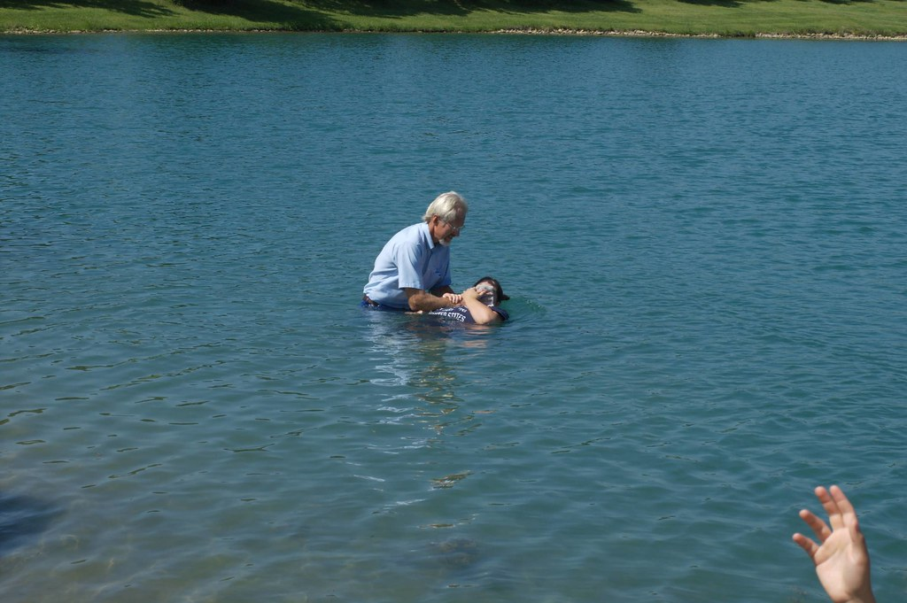
Are You Heard by God?
There is also an antitype which now saves us--baptism (not the removal of the filth of the flesh, but the answer of a good conscience toward God), through the resurrection of Jesus Christ 1 Peter 3:21
Notes:
Lu 18:10 "Two men went up to the temple to pray, one a Pharisee and the other a tax collector. 11 "The Pharisee stood and prayed thus with himself, 'God, I thank You that I am not like other men--extortioners, unjust, adulterers, or even as this tax collector. 12 'I fast twice a week; I give tithes of all that I possess.‘ 13 "And the tax collector, standing afar off, would not so much as raise his eyes to heaven, but beat his breast, saying, 'God, be merciful to me a sinner!‘ 14 "I tell you, this man went down to his house justified rather than the other; for everyone who exalts himself will be humbled, and he who humbles himself will be exalted.“
Mr 11:25 "And whenever you stand praying, if you have anything against anyone, forgive him, that your Father in heaven may also forgive you your trespasses.

